Slide 1
First Nations deep poverty in the NT: New economy ideas towards community solutions
Jon Altman
School of Regulation and Global Governance
The Australian National University

Slide 2
Outline of talk
Big picture policy settings
Closing the gap nationally and in the NT
Some reasons for enduring failure
Emerging ‘new economy’ opportunities
Storying successes
Prospects for improvement

Slide 3
The two policy options on offer: the false dichotomy
Assimilation (1961): sameness/settler colonial modernisation project/Promised delivery of (individual) citizenship equality
All aborigines and part-aborigines [sic] are expected to attain the same manner of living as other Australians and to live as members of a single Australian community enjoying the same rights and privileges, accepting the same responsibilities, observing the same customs and influenced by the same beliefs, hopes and loyalties as other Australians
Self determination (1972): potential for difference/postcolonial possibility paradigm/Promised right to live differently
Aboriginal communities deciding the pace and nature of their future development as significant components within a diverse Australia
Notes:
Here I define the two broad approaches evident in Australian government policy, assimilation and self determination. The broad goal of the settler state is assimilation sometimes also called integration or normalisation or mainstreaming; some like Patrick Wolfe argue that what is on offer is assimilation or elimination and I concur with this view. The other option, much preferred by most Indigenous peoples is self determination first introduced in 1972 by the Whitlam government. Assimilation treats Indigenous people as the same as other Australians, self determination leaves open possibilities to recognise diversity and difference

Slide 4
Indigenous population estimates, 1971-2021
Notes:
This diagram shows the census outcomes from 1971; the 1971 census was the first when Indigenous people could self-identify. And the figures here are the estimates of the population after upward adjustment of the census count which always under-enumerates the indigenous population usually by about 20% with significant regional and state/territory variations

Slide 5
Indigenous census counts by State and Territory 1971-2021
Notes:
In this diagram I show changes in the census counts (not estimates) between states and territories. What is extraordinary here is how rapidly the population has grown in NSW and Queensland. This is not because of natural increase or migration but mainly because Indigenous people often living in households of mixed ethnicity are more willing or choose to identify as indigenous. This changing composition creates real problems for public policy in targeting Indigenous people in need. Note that between some census Indigenous people shift their identity, in and out of claiming indigeneity although in most cases the trend is to claim indigeneity

Slide 6
Policy | Target | ‘Equality’ goal | Timeframe | outcome
AEDP 1987-2000 | Income equality | 100% | 2000 | Failed
 | Employment | 100% | 2000 | Failed
 | Education | 100% | 2000 | Failed
 | Welfare dependence | 100% | 2000 | Failed
CTG 1 2008-2018 | Life expectancy | 100% | 2031 | Failed
 | Infant mortality | 50% | 2018 | Failed
 | Preschool attendance | 95% | 2013/2025 | Succeeded
 | Year 12 completion | 50% | 2020 | Succeeded
 | Literacy/numeracy | 50% | 2018 | Failed
 | School attendance | 100% | 2018 | Failed
 | Employment | 50% | 2018 | Failed
CTG 2 2020-2031 | 1 Life expectancy | 100% | 2031 | Not on track
 | 2 Healthy birth weight | 91% | 2031 | Not on track
 | 3 Preschool attendance | 95% | 2025 | On track
 | 4 Child development | 55% | 2031 | Worsening
 | 5 Year 12 completion | 96% | 2031 | Not on track
 | 6 Tertiary qualifications | 70% | 2031 | Not on track
 | 7 Employment, education, training (15-24 years) | 67% | 2031 | Not on track
 | 8 Employment (25-64 years) | 62% | 2031 | On track
 | 9 Housing not overcrowded | 88% | 2031 | Not on track
 | 10 Adults in prison | -15% | 2031 | Worsening
 | 11 10–17-year-old detention | -30% | 2031 | On track
 | 12 Out of home care | -45% | 2031 | Worsening
 | 13 Violence and abuse | -50% at least | 2031 | No assessment
 | 14 Suicide | Towards zero | none | No assessment
 | 15 a. Land and b. sea ownership | +15% | 2030 | On track
 | 16 Languages use | Sustained +ve | 2031 | No assessment
 | 17 Access to information | Equality | 2026 | No assessment

Slide 7
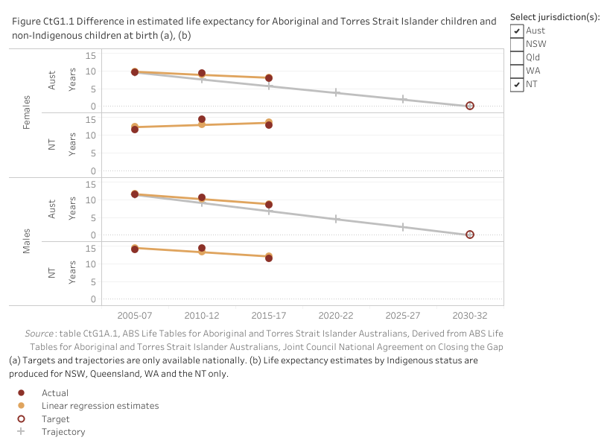
Target 1 Close the Gap in life expectancy within a generation, by 2031

Slide 8
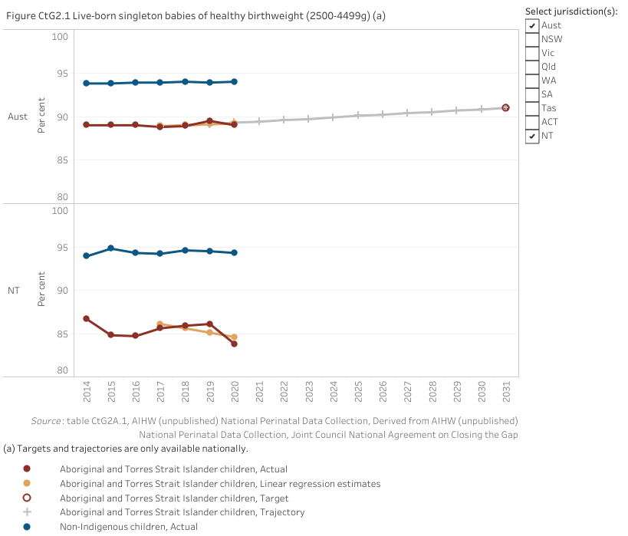
Target 2 By 2031, increase the proportion of Aboriginal and Torres Strait Islander babies with a healthy birthweight to 91 per cent

Slide 9
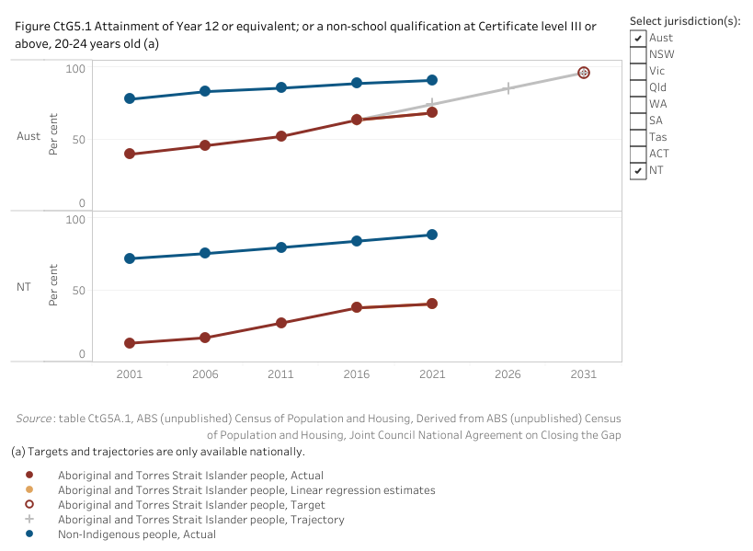
Target 5 By 2031, increase the proportion of Aboriginal and Torres Strait Islander people (age 20-24) attaining year 12 qualification to 96 per cent

Slide 10
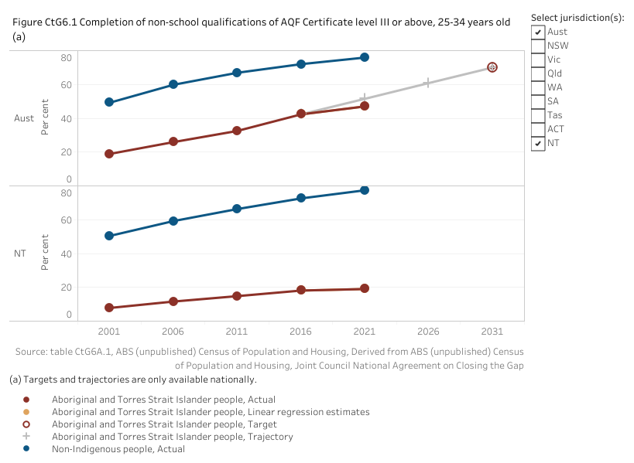
Target 6 By 2031, increase the proportion of Aboriginal and Torres Strait Islander people aged 25-34 years who have completed a tertiary qualification (Certificate III and above) to 70 per cent

Slide 11
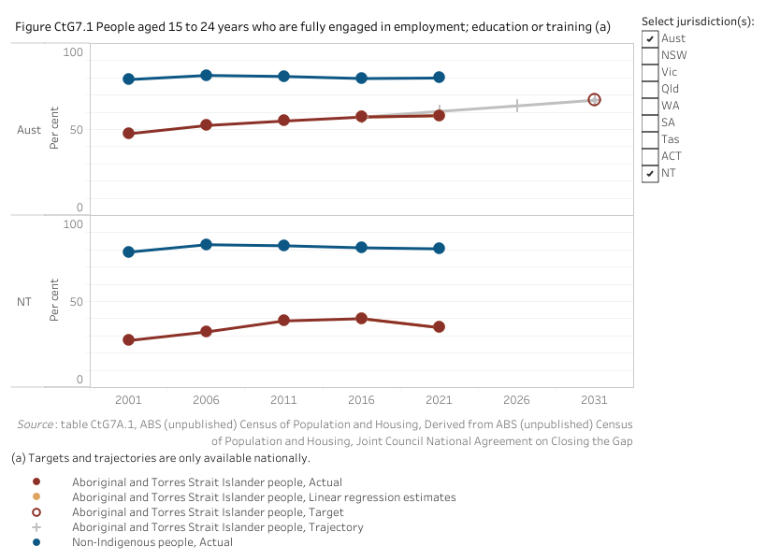
Target 7 By 2031, increase the proportion of Aboriginal and Torres Strait Islander youth (15-24 years) who are in employment, education or training to 67 per cent

Slide 12
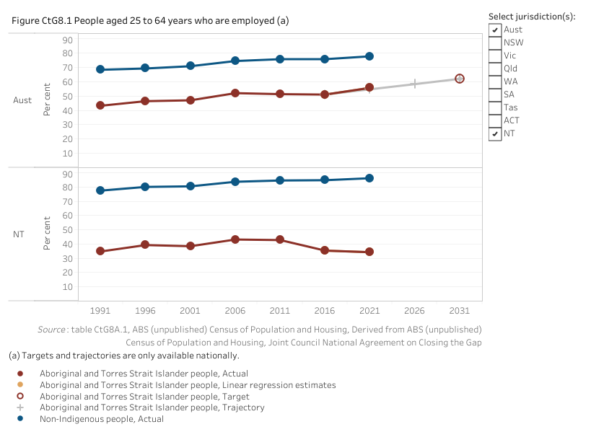
Target 8 By 2031, increase the proportion of Aboriginal and Torres Strait Islander people aged 25-64 who are employed to 62 per cent

Slide 13
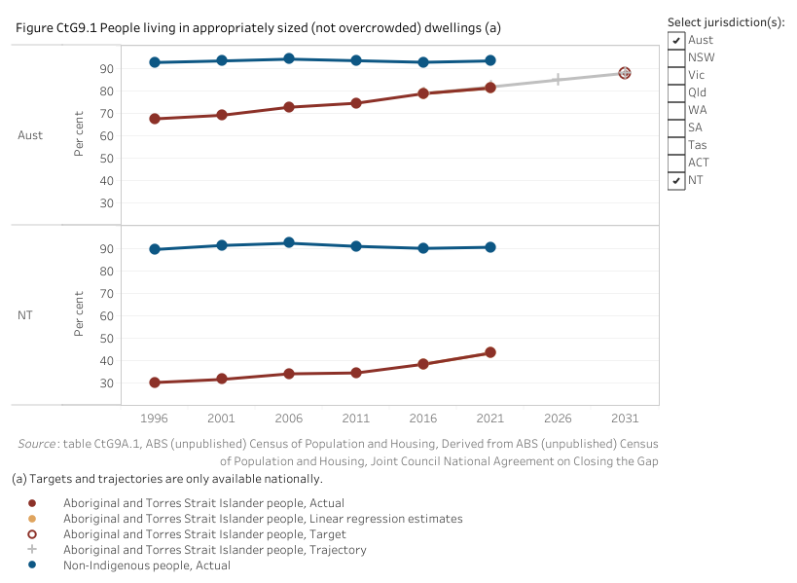
Target 9 By 2031, increase the proportion of Aboriginal and Torres Strait Islander people living in appropriately sized (not overcrowded) housing to 88 per cent

Slide 14
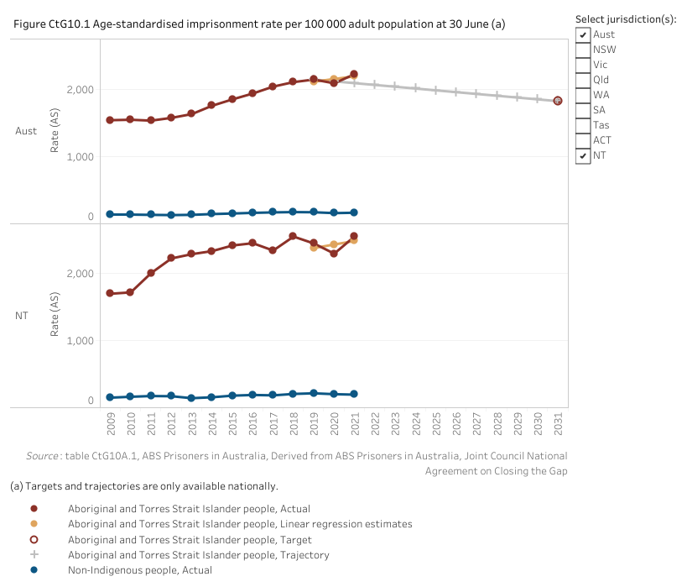
Target 10 By 2031, reduce the rate of Aboriginal and Torres Strait Islander adults held in incarceration by at least 15 per cent

Slide 15
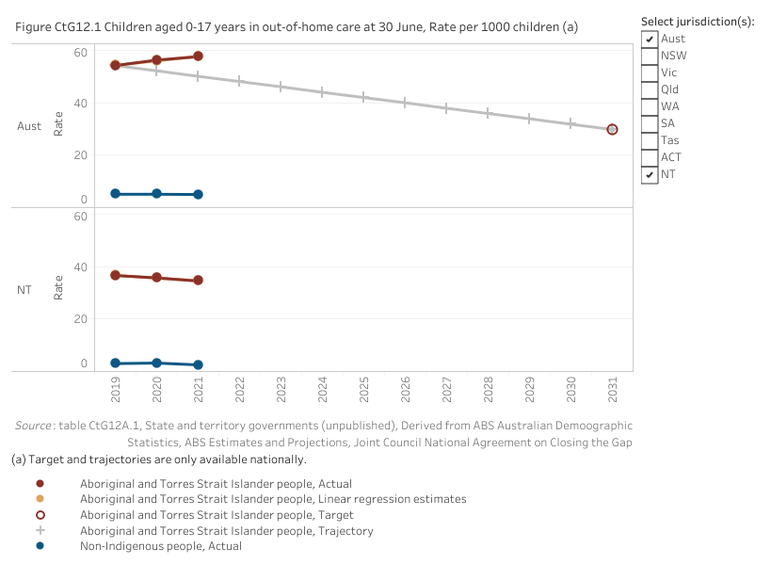
Target 12 By 2031, reduce the rate of overrepresentation of Aboriginal and Torres Strait Islander children (0-17 years old) in out-of-home care by 45 per cent

Slide 16
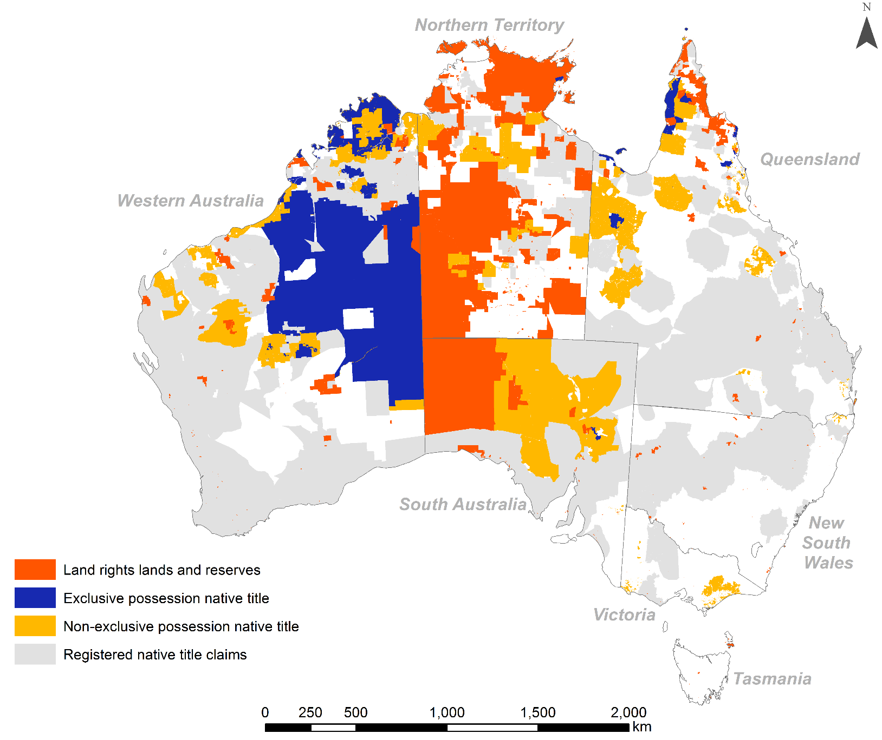
Land rig Indigenous land holdings and ‘registered claims’ and registered claims

Slide 17
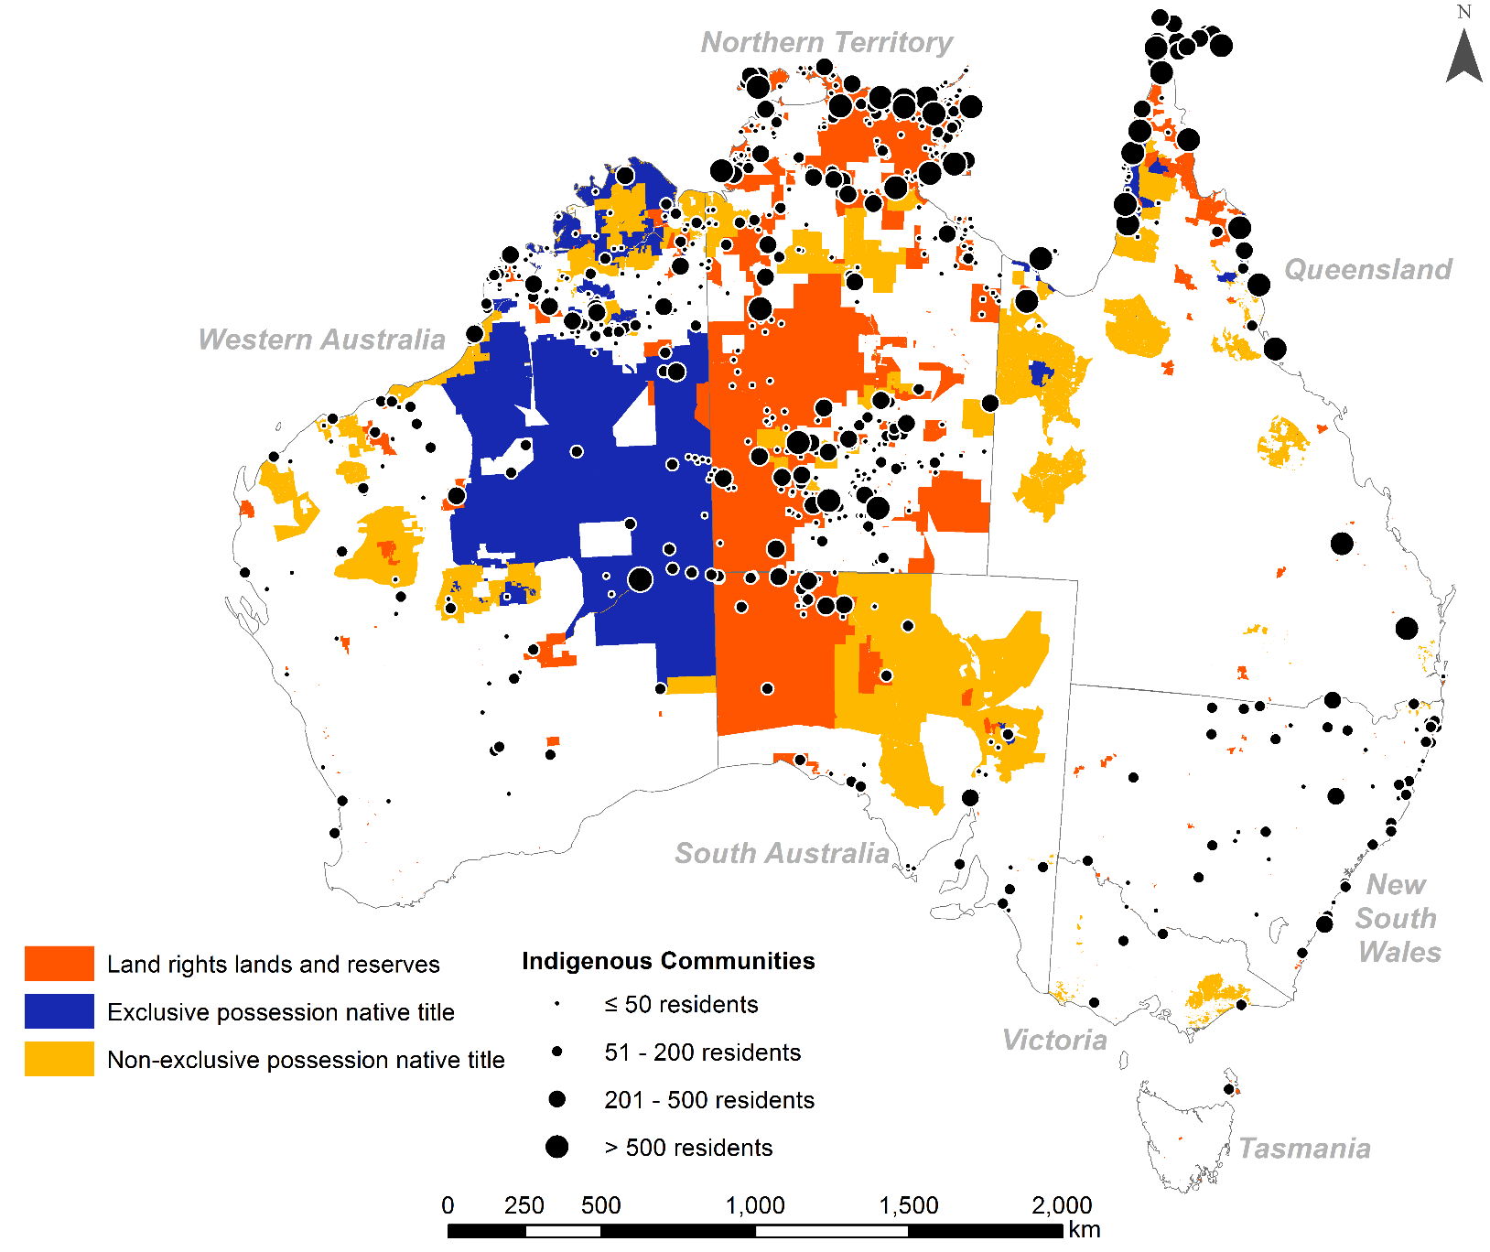
Indigenous land holdings and ‘discrete communities’ of Discrete Indigenous Communities

Slide 18
Why is the National Agreement on Closing the Gap failing?
The CTG framework lacks a clear policy logic and coherence
There are massive historical backlogs but no objective assessment of need
The 2017 Indigenous Expenditure Report shows that much of the spend on Indigenous people is due to extra cost of service delivery
Too much expenditure is negative, on incarceration, and too little is positive, on education and training of the young; too much is palliative, fixing health problems and too little is preventative, adequate shelter, and too much is imposed not invited and at times resisted
Targets are unclear - the national population that is growing exponentially or remote communities whose residents are in greatest need
There is too much duplication and waste and unclear demarcations between federal and state agencies (46%/54%) and mainstream and Indigenous specific programs (82%/18%)?
There is too little community-control
There is too much room for buck passing (inclusive now of local governments and First Nations organisations under the National Agreement)
Notes:
Here are the five broad areas of the IAS and my somewhat cynical comments on how these policies are implemented.

Slide 19
Why is the National Agreement on Closing the Gap especially failing in the Northern Territory?
Massive colonial legacies and ongoing neglect
Remoteness means absence of mainstream opportunities
Numerous small communities challenge standard service delivery approaches
There is much resistance to imposed policies of sameness
The century old ‘develop the north’ mentality has served Indigenous people badly but continues in new forms today
There is too little attention to Indigenous ‘voices’ and priorities
The NTER and Stronger Futures approaches (2007 to the present) have been expensive failures
CDP has been an impoverishing disaster; income management is ineffective and expensive; NT public housing is inadequate; etc etc
Governmental social engineering has destroyed community organisations
Notes:
Here are the five broad areas of the IAS and my somewhat cynical comments on how these policies are implemented.

Slide 20
The result of poor governance is deep and deepening poverty
Only 3-4 in 10 adults are employed
Being on Newstart/CDP is a recipe for livelihood misery and deep poverty
More than 50% of Indigenous people in the NT live under the poverty line
High prices for goods and services result in food and energy insecurity, alongside over-crowded housing leading to …
High morbidity and premature death and youth anomie
And current increased migration to urban centres and social disruption by youth is linked to outbursts of deep discontent
Notes:
Here are the five broad areas of the IAS and my somewhat cynical comments on how these policies are implemented.

Slide 21
Proposals for national reform
Reframe the National Agreement to CTG to properly recognise the diverse realities of First Nations people’s lives
Quantify the extent of needs and backlogs and fund and deliver equitably
Where does the money go? Revive the Indigenous Expenditure Report
How are resources spent: are programs invited or imposed?
Distinguish citizenship rights from special ‘First Nations’ rights
Recast policy to recognise different ways of living and diverse aspirations
Where people aspire to join the mainstream support them in the quest for sameness aware of legacies and discrimination
Where people aspire to live differently support them in the quest for difference even on country without ignoring their citizenship rights
Differentiate those in greatest need
As individuals/families, mainly in urban and township settings
As ‘discrete’ communities, mainly in remote Australia

Slide 22
Proposals for NT reform in the ‘new’ economy
Since May 2022 we have a new government with new national priorities to:
Decarbonise by 2050
To switch the economy from fossil fuel dependence to renewables
To enhance biodiversity and repair nature
To constitutionally embed an advisory Voice to the parliament and executive
First Nations people in the NT are already engaged in biodiversity conservation and decarbonization projects on their lands (as I will show from my research)
And First Nations lands are highly prospective for the transition to renewables despite remoteness
This is a propitious moment for First Nations people in the NT
It is essential that the national projects of decarbonization and ‘nature repair’ are properly inclusive of First Nations lands and people and aspirations
Australia will fail to decarbonize and protect nature unless it decolonizes

Slide 25


Slide 26
Notes:
A savanna burning project is a registered eligible offsets project operating under a savanna burning methodology determination
This is a map of all the currently registered savanna burning projects

Slide 27
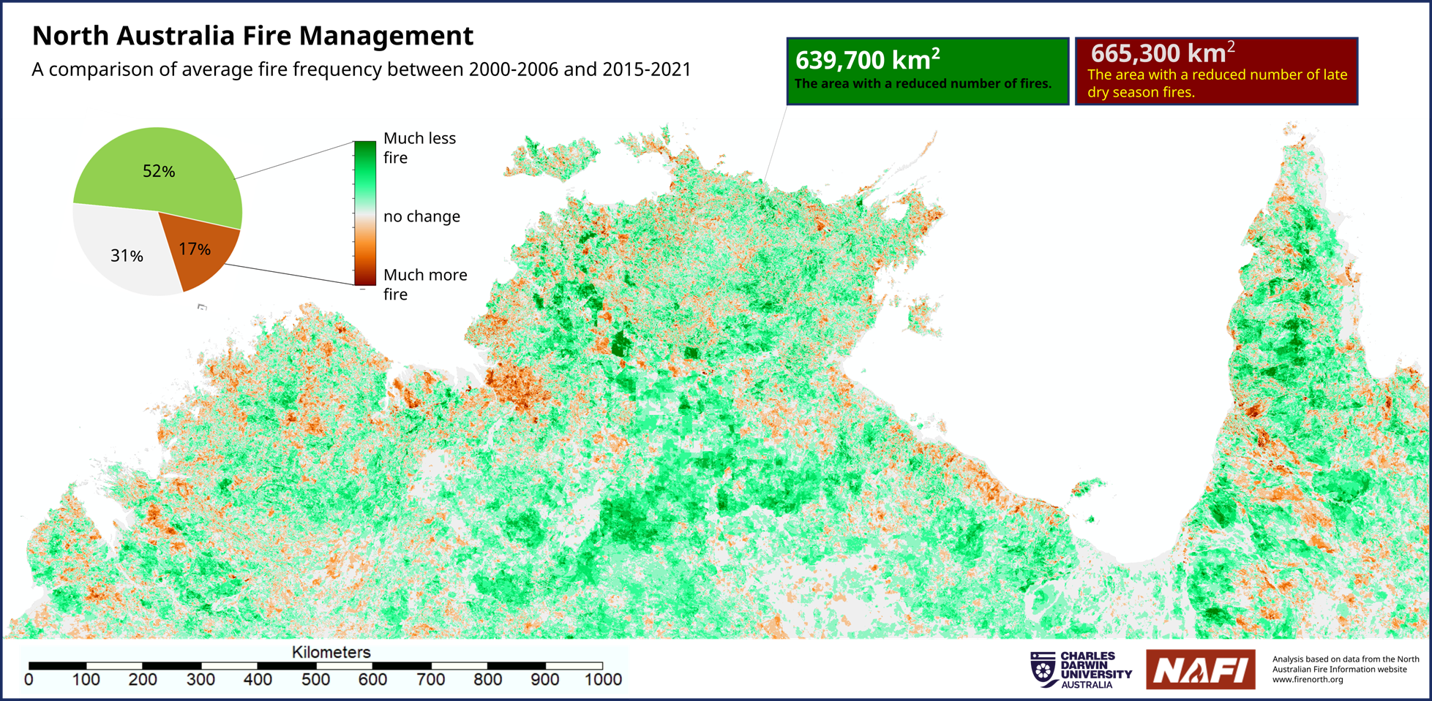

Slide 28
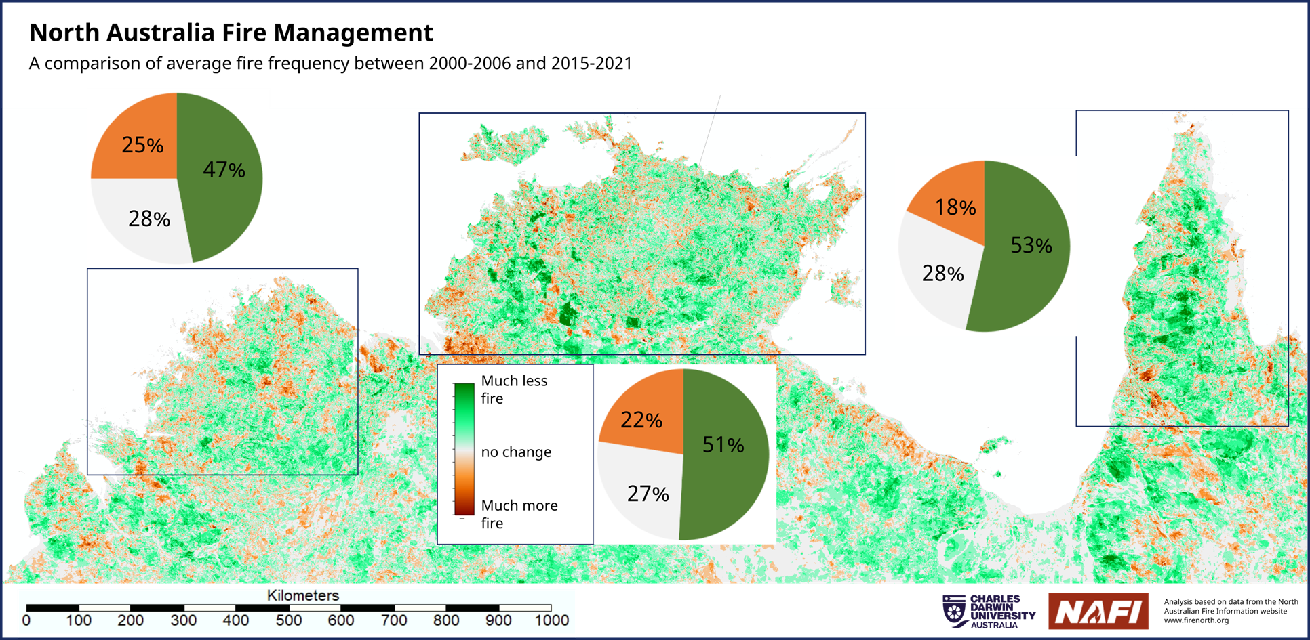

Slide 29





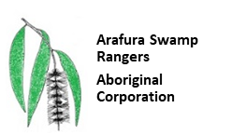







Slide 30








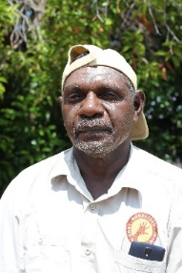
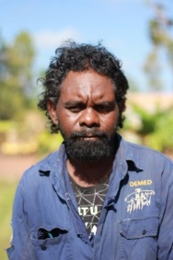
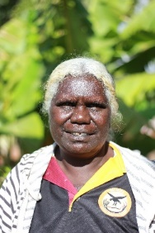

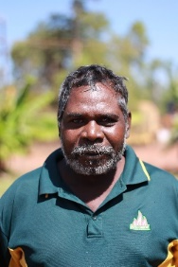
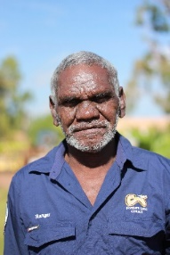
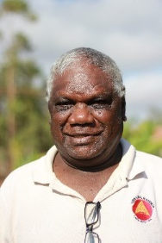

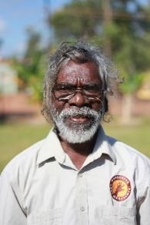
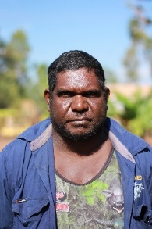
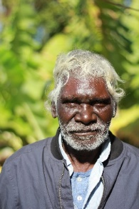
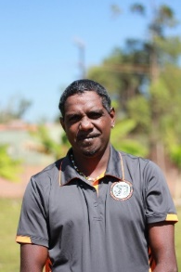
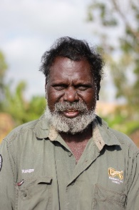
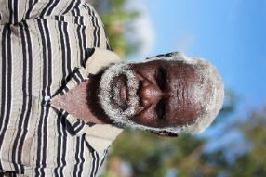

Traditional Landowners
ALFA Membership
Djelk
WLML
Adjumarlarl
Mimal
Jawoyn
ASRAC
SEAL
Yirralka
Arafura Swamp Rangers
Aboriginal Corporation

Slide 31
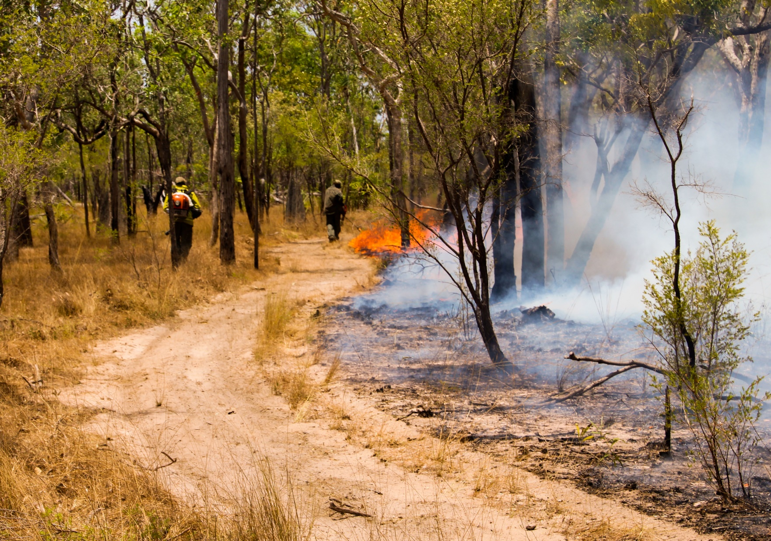

Slide 32
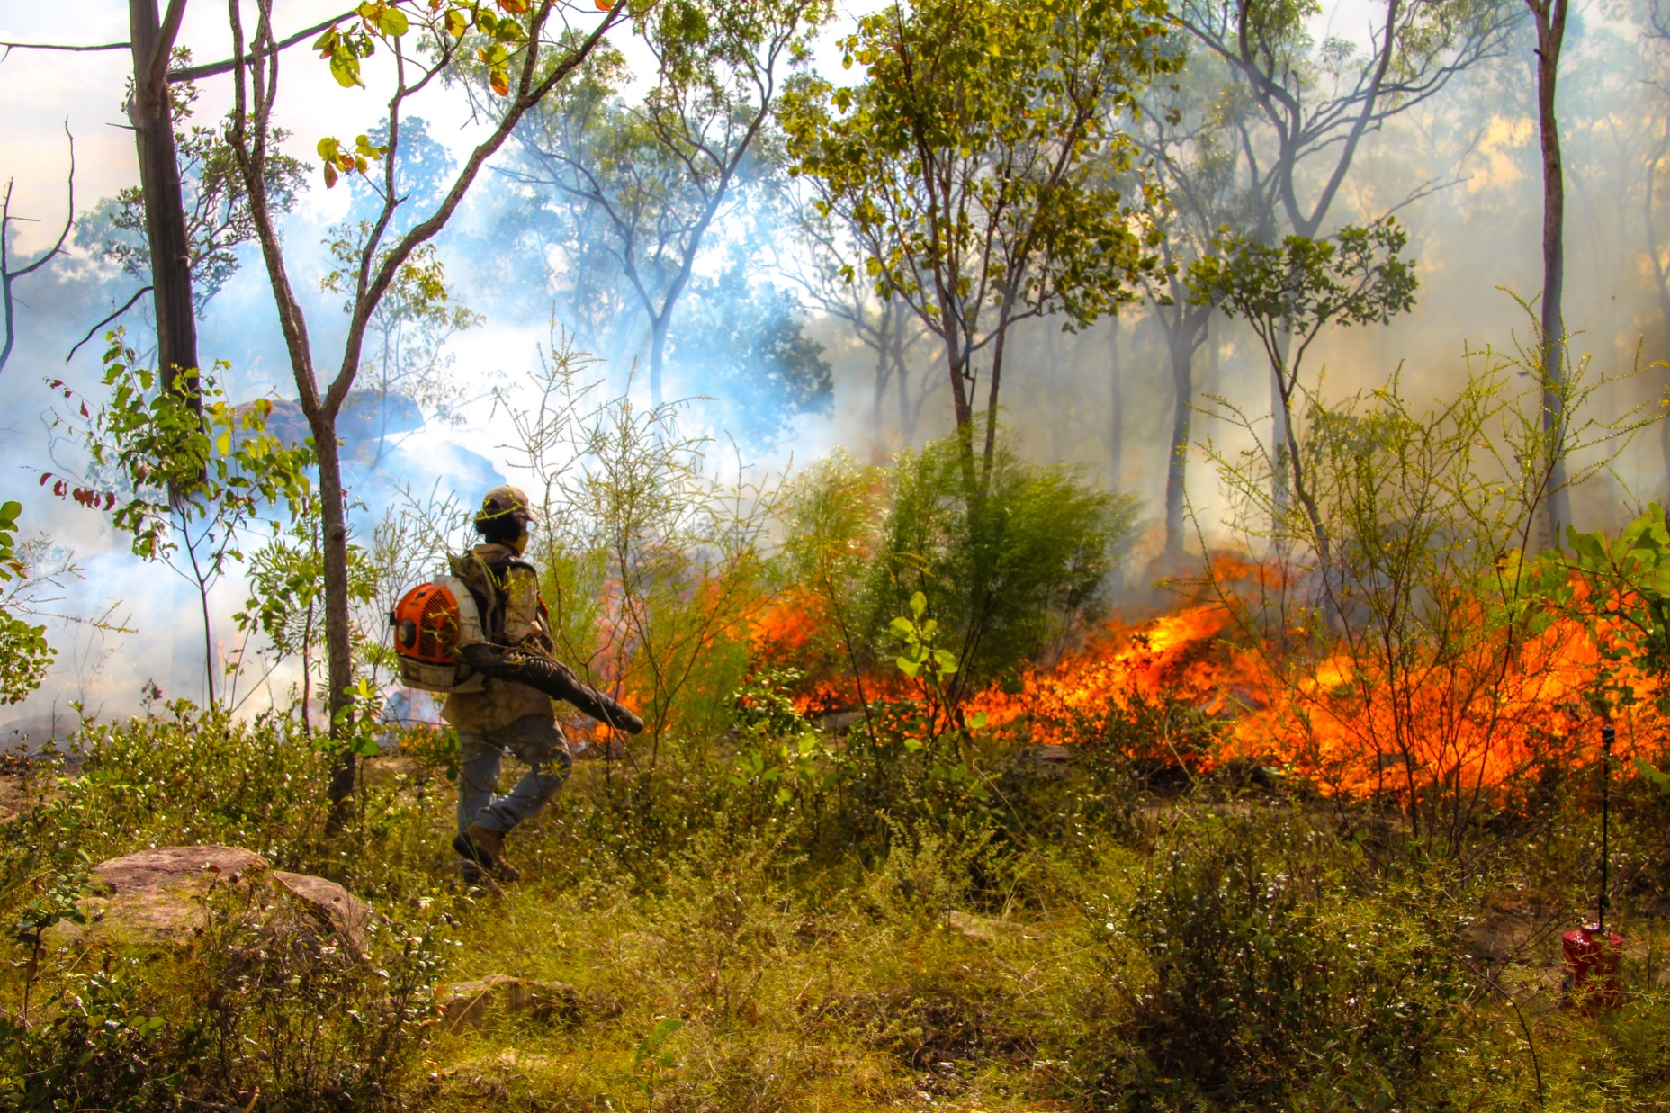

Slide 33
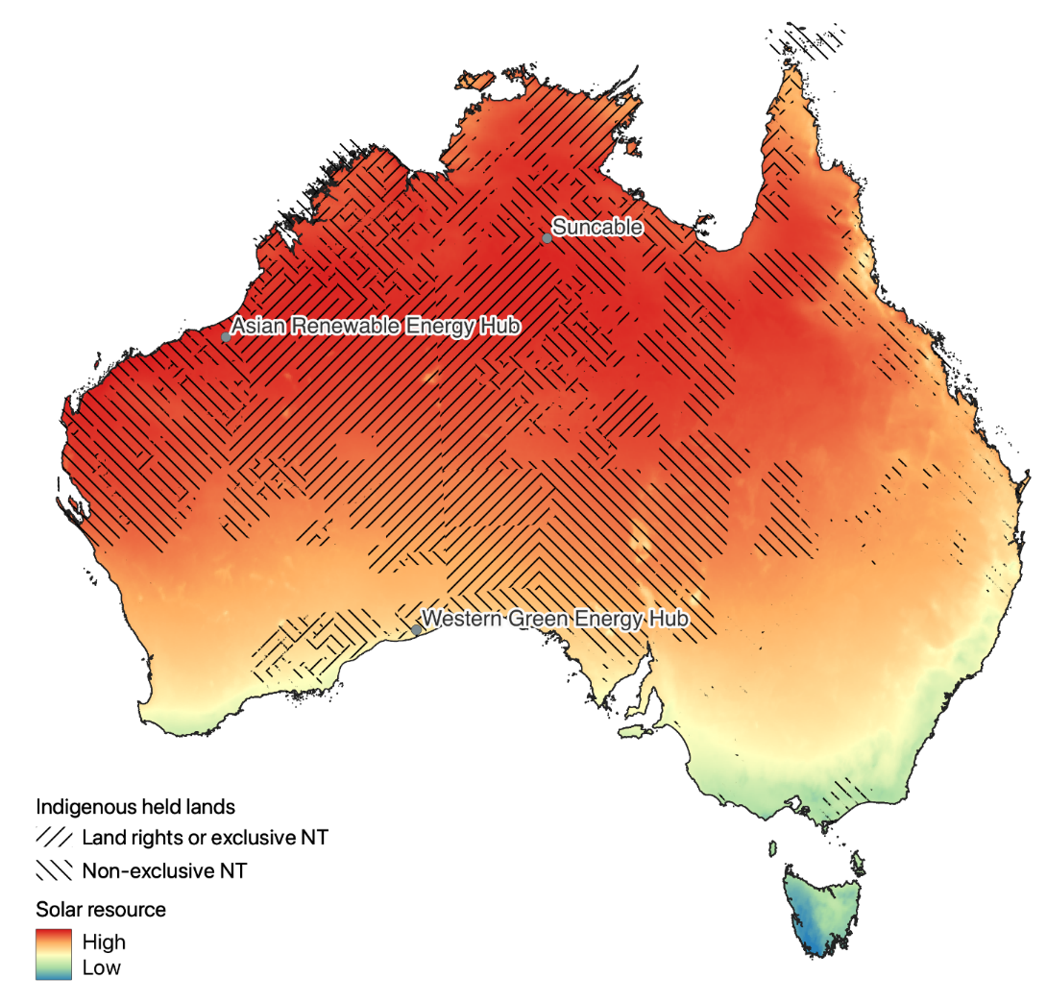
Solar resources and 3 mega projects on Indigenous land

Slide 34


Slide 35
Concluding observations and the need to change the storying
It is not a choice between sameness or difference both are required: the delivery of citizenship entitlements for sameness and self-determining support for difference, including for living and working on country
Governments must engage with, properly resource and listen to an impressive array of First Nations alliances and voices at national and industry levels that are advocating for First Nations people in Caring for Country, the Carbon Industry, and the Transition to Renewables alongside Heritage Protection
Australia will neither decarbonise nor repair nature without decolonisation; the storying has to change from what the state does (badly) ‘for them’ to what they do (well) ‘for us’ now and into the future
This new approach will require new forms of engagement and devolution: recognition, representation, respect, remuneration and redistribution (5 Rs)
The new economy and decolonisation can provide new means for community-led solutions to address current deep and unacceptable levels of poverty

