Slide 1
National Disability Insurance Scheme (NDIS)
NDIS (Northern Territory) and Mental Health
Archie Baker
Director of Service Delivery NT
National Disability Insurance Agency (NDIA)
1 May 2014

Slide 2
The NDIS is the new way of delivering disability support
Supports tailored to individual needs
Insurance approach for more stable long term costs and better outcomes
Choice and control is central
Needs driven rather than rationed funding
Delivered in local community
Working towards national coverage
Notes:
A nation-wide, demand-driven system of supports tailored to the needs of individuals with permanent and significant disability that has a substantial impact on their participation in everyday life.
Once fully implemented it will provide scheme participants with certainty about their future disability support needs and with genuine choice and control over their support arrangements – what types of supports, who provides them and how and where they are provided.
Driven by individual demand rather than what is currently available through narrow programmatic responses to need, the scheme is intended to be flexible so that it responds to changes in support needs as people’s needs change.
Legislation is in place that sets out the provisions for supporting for people with disabilities under the scheme. It also provides powerful principles and objects that focus on the outcomes to be achieved and how we go about providing necessary supports.
With Western Australia having agreed to a two year pilot commencing on 1 July 2014, we can confidently work towards national coverage – and when fully implemented, a scheme that will be portable, equitable and consistently applied.

Slide 3
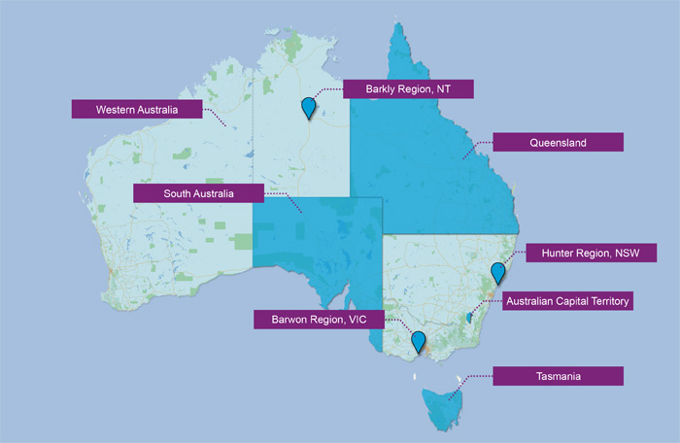
7 trial sites are being established over the next 3 years
On 1 July 2013, the first stage of the NDIS commenced in:
South Australia
Tasmania
The Hunter in NSW and
The Barwon area in Victoria
The ACT and NT will join the first stage on 1 July 2014
Western Australia will commence a two year pilot from 1 July 2014
Notes:
Launch sites commenced on 1 July 2013 in NSW, VIC, SA and Tasmania.
July 2014 launch locations
Australian Capital Territory—for people under 65 years.
By July 2019, all ACT residents with permanent and significant disability who meet the access requirements—around 5,000 people—will be supported by the scheme.
Northern Territory—for people under 65 in the Barkly region who meet the access requirements.
Western Australia – a two year NDIS pilot for people under 65 - about 4,100 people residing in the Perth Hills local government areas of Kalamunda, Mundaring and Swan. The WA government will also commence operating two My Way sites .
Queensland - all people under 65 who meet the access requirements, commencing in July 2016.

Slide 4
The primary aim of the Scheme is to increase participation
Consistent with UN Convention on the Rights of Persons with Disabilities - aim to achieve full social and economic participation of people with disability
Scheme design assumes people with disability will participate to the extent they are able
Increased economic participation translates to better long term outcomes for individuals and communities
Higher participation rates will permanently deal with social constraints of disability
Scheme will work to ensure that other supports, such as employment assistance, which are provided by other systems, are accessible
Scheme will fund reasonable and necessary disability supports required to achieve participation
Notes:
Also focus on individualised approach, funding linked to goals, aspirations and needs, with expectation that support outcomes can be addressed in flexible “participant driven” ways.
Important to acknowledge that Scheme is not intended to, nor will it fund what ought to be rightly funded by other systems.
Acknowledge early days and need to learn from launch.

Slide 5
How things are changing under the NDIS
Feature | Former system | NDIS
Access criteria | Vary from state to state | Nationally consistent as set out in legislation
Choice and control | Varies from state to state - most people have little say over the supports they receive | Individual has control over the type and mix of supports, delivery and how their funding is managed
Level of assistance | Capped – people may be eligible but can spend years on waiting lists | Demand driven – people with disability get the support they need, when they need it, to make progress towards goals
Funding | Multiple programs within and across governments | Single funding pool (pooling contributions from Commonwealth, States, Territories) administered by NDIA

Slide 6
Three key pillars underpin NDIS design
Insurance Approach
Supports economic and social participation. Mobilises funding for early intervention Estimates and manages resource allocation based on managing long term costs across the life-course of individuals Shares the cost of disability across the community
Choice and Control
Participants determine how much control they want over management of their funding, supports and providers Scheme gives effect to certain obligations under the Convention on the Rights of Persons with Disabilities - including respect for their worth, dignity and to live free from abuse, neglect and exploitation
Community and Mainstream
People are supported to access and coordinate community and funded supports The scheme will not duplicate or replace mainstream services Effective interface with mainstream and community supports is central to the sustainability of the Scheme

Slide 7
People from diverse backgrounds contributed to design
Specific activities that have included CALD community are:
Small group sessions in the Barwon Area and Hunter Area in March 2013
Participation in the Alliance CALD roundtable 12 March 2013
Federation of Ethnic Communities Council Australia (FECCA) represented at Not For Profit round table at Parliament House 27 May 2013 with Minister Macklin
Agency’s field testing of assessment process with CALD groups
Specific outcomes from these have been:
Cultural sensitivity training for frontline staff
Consultants engaged to assist in addressing the particular needs of CALD communities in launch sites including translated materials
Ongoing engagement with CALD communities will occur.
Notes:
NDIA engagement activity has included a focus on people with disability from culturally and linguistically diverse backgrounds, as an important target group.
Through our engagement activities we have heard from a number of people from diverse backgrounds and understand that there are likely to some additional needs and sensitivities that the Agency will take into account ensure when working with scheme participants who are from diverse backgrounds.
Our approach to employment of local area coordinators includes consideration of the need for representation of people from diverse backgrounds in each of the launch sites.
This is part of the scheme’s intent to ensure that it is accessible to all people with disability people, including those from culturally diverse backgrounds.
As well as making sure we have staff members who are sensitive to the needs of people from CALD background, the training provided to all frontline staff include a component on culturally sensitivity delivered by a CALD Community Group in each state, tailored to each launch location.
In terms of our assessment tool -, these have been tested in launch sites, which has included opportunities with people from diverse cultural backgrounds.
People with disability who are from a culturally diverse background will be dealt with in a culturally sensitive way by the NDIA to ensure that they are fully supported to make decisions and to exercise choice and control.
In the longer term, the Agency will also look to provide its printed materials in other languages, appropriate to the launch locations.
In the event that a person with disability requires language assistance for their interaction with the Agency, this can be arranged and paid for by the Agency.
As the scheme rolls out, the ndia will continue to engage locally to make sure that the access needs of people with disability from diverse backgrounds continue to be considered and accommodated.
Examples of CALD engagement by the Agency in 2013 to date:
A workshop with a support group from the Diversitat – in Geelong on 13 March
A workshop with potential participants and carers from a CALD background – Newcastle on 21 March
A meeting with the Multicultural Communities Council of SA – Adelaide on 8 May. At this meeting it was agreed that an information forum for the Multicultural Communities Council of SA members would be held at a later date to be confirmed.

Slide 8
People with disability from Indigenous backgrounds
Establishment of a Local Reference Group, with current support providers and Aboriginal organisations from the Barkly region
Indigenous Australians have a significantly higher rate of disability compared to non-indigenous people
Recognised that many Indigenous people with disability do not identify as having a disability
Priority group for engagement will need to tailor communication tools to acknowledge cultural diversity
Developing support responses in the NT region
Recognised need to develop participation of local people and increase the number of Indigenous people in employment
Notes:
First People’s Disability Network funded through Sector Development fund to raise awareness, build capacity of people and organisations, improve cultural competence and increase Indigenous workforce
Scheme launch in Barkly region of NT in July 2014 – together with experience in delivering the NDIS to children in remote SA – will help to inform future roll out to Indigenous people

Slide 9
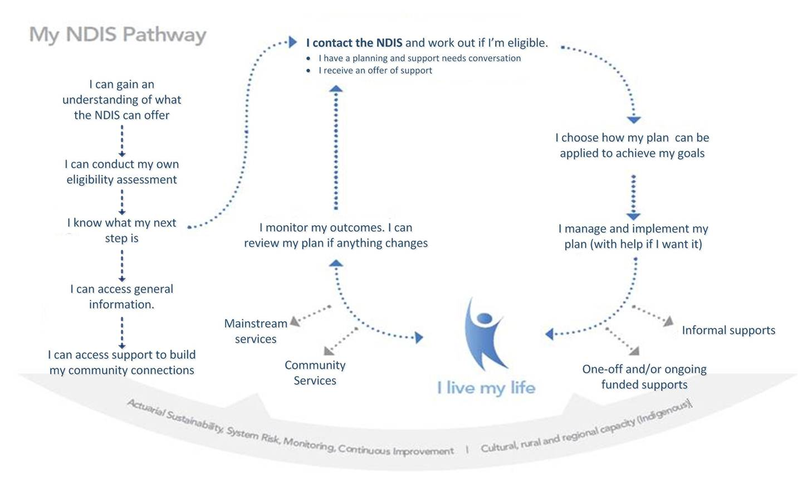
The pathway will be clear and simple
Notes:
This is the participant pathway for the Scheme
The planning and assessment framework for launch uses a multi-layered structure to provide a flexible, efficient and individualised approach centred on goals, aspirations and support needs, with assessment including specialist assessment, only when required (see diagram).
Critical elements are:
Wide gateway
Eligibility assessment that ensure the scheme is targeted appropriately
Goal based planning approach and decisions around plan management.
The participant is in the driving seat and will be supported to complete the process where necessary. This is proving to be a new concept for participants new to the Scheme.

Slide 10
Referral and linkages
Diverse range of support available through the Scheme: provision of information, referral to other systems, linking in the community and specific disability supports
Funded supports in a participant’s plan are always about support for the participant
Plans can include support for sustaining informal care and supports that allow the participant to be involved in social, community and family activities
Supports for participants takes into account what care carers and families are willing and reasonably able to provide and what additional support needs to be funded
Notes:
Funded supports are always for the participant.
Supports can be included to sustain informal care and for the participant to participate in social, community and family activities.
Supports for participants take into account what carers and families are willingly and reasonably able to provide.
Funded supports can be put in place to enable families and carers to undertake family activities together.
Funded supports can include activities that are intended to support the informal care arrangements e.g. training courses for family members.
LAC or funded support can be provided to build family capacity.

Slide 11
Role of Local Area Coordinators (LACs)
Provide participants with information, referral, assistance and support
Ensure people with disability are linked to community life and providers of supports
Assist to coordinate supports participants receive internal and external to the Scheme
Active role in the community to positively influence community attitudes to inclusion and work to address systemic barriers to participation
Advocate on behalf of participants of the Scheme
Notes:
If the support is something that the health or mental health system would be responsible for providing, a LAC can assist a participant to make contact and discuss their needs with appropriate providers.

Slide 12
The NDIS and other service systems
General policy approach acknowledges a boundary between NDIS and other systems:
NDIS will not duplicate supports rightly provided by other service systems such as health, education, transport etc.
Establishing boundaries ensures:
Clarity for all service systems and Agency decision makers
Nationally consistent approach
Any interface areas requiring clarity will be resolved within launch sites in the first instance, and where further consideration is required will progress to States and Commonwealth
Notes:
If other systems do not provide, NDIS will not normally step in.
There will not be ‘top-ups’ for other systems which aren’t performing (including where there is unmet demand/waiting lists).
The details about how interface arrangements between the NDIS and other service systems will work in practice will be determined over time, as more and more participants enter the scheme and discussions are progressed between governments about ensuring continuity of service, particularly for those people who may not meet the access requirements for the scheme (but still require a service).

Slide 13
What is the interface?
Context for ‘reasonable and necessary’
assists the participant to pursue goals, objectives aspirations
supports social and economic participation
value for money
is (or likely to be) effective and beneficial
beyond what is reasonable to expect families, carers, informal networks and the community to provide
Most appropriately funded by the NDIS, not through other systems.

Slide 14
Mental Health: Guiding principles
NDIS | Managing a person’s ongoing function impairment Examples; assistance with planning and decision making, community access
Mental health system | Diagnosing and treating a mental health condition Examples; general practitioner, psychiatry & psychology, pharmaceuticals
Notes:
NDIS
Managing a person’s ongoing functional impairment
ongoing functional impairment
enable activities of daily living and participation
community-based, non-clinical
Examples: assistance with planning and decision making, community access
Mental health system
Diagnosing and treating a mental health condition
diagnosis
clinical treatment (in the community or in health settings)
residential care, including inpatient treatment or clinical rehabilitation
all early intervention
Examples: general practitioner, psychiatry, psychology, pharmaceuticals.

Slide 15
Mental Health: Service offer
Always NDIS | Context dependent | Always Mental Health
Personal and domestic assistance Engagement support Skills and capacity building Supported residential accommodation (non-clinical) Transport | Complex case management Counselling Social work support | Diagnosis Clinical treatment All early residential care (clinical) Clinical mental health outreach and crisis services
Notes:
Always NDIS
Personal and domestic assistance – assistance with hygiene, household tasks
Engagement supports –assistance to engage with the mental health system (e.g. decision making support)
Skills and capacity building – social relationships, communication, financial management, tenancy support
Supported residential accommodation (non-clinical)
Transport – assistance to attend medical appointments where transport assistance is a support the participant requires as part of their plan
Context dependent
Complex case management services
NDIS and Health: Can be funded by either, depending on the circumstances
Counselling and social work support –
NDIS : where it is a stand-alone community service offer
Health: where it is integrated as part of a predominantly clinical package of support
Always mental health
Diagnosis of psychiatric conditions
Clinical treatment – general practitioner, psychiatry, psychology, pharmaceuticals, clinical care in the community
All early interventions – including clinical and community-based
Residential care (clinical) – include hospital based in-patient facilities
Clinical mental health outreach and crisis services

Slide 16
People with psychiatric disability and the NDIS
A person with permanent and significant disability attributable to a psychiatric condition may be able to access assistance from NDIS
Access to Scheme support based on the degree to which a person’s permanent disability – including psychiatric impairment - impacts on their ability to participate in everyday life including work, education and in the community
The Scheme will be responsible for non-clinical supports such as personal care and domestic assistance
The My Access Checker is first point of contact - online tool gives an indication about whether a person may be able to access assistance from the Scheme
Notes:
The access requirements for the Scheme include people with a psychiatric condition who have significant and permanent functional impairment. Most of these participants will have a range of support needs that will be provided both from the Scheme and the health and mental health systems.
Some participants in the NDIS may not enter the scheme due to a psychiatric condition, but also require mental health services and supports.
In the area of mental health, NDIS assists a person with the impact of disability or a psychiatric condition, but does not fund the treatment of any health or mental health conditions.
Access to support from NDIS
Live in Australia as a permanent resident of Australia; and
Be under 65 years of age; and
Meet the disability requirements; and/or
Meet the early intervention requirements
To meet the “disability requirements” means having a significant and permanent disability that affects communication, mobility, self-care or self-management
To meet the “early intervention requirements” means having a disability or developmental delay where early intervention support would likely reduce the person’s future needs for supports in relation to disability
You can only get a clear answer on accessing support from the scheme by undergoing the planning and assessment process.
Whether a person is in receipt of a Disability Support Pension (DSP) or not has no bearing on access for the Scheme. A person who is receiving the DSP who also meets the access requirements for the Scheme, they would continue to receive the DSP. This is because NDIS funding pays for disability supports and is regarded as separate from any income support payments.
My Access Checker
People with disability who think they may meet the access requirements can complete the My Access Checker online. This short tool asks demographic and support needs questions and provide the individual with an indication about whether they may be able to access support from the scheme. If the tool provide such an indication, the person is then directed to contact the Agency to make an appointment with a planner.
NDIS will be responsible for non-clinical supports for participants with psychosocial disability. These could include:
Support for community integration and day-to-day living
Therapy that would manage or reduce the functional impact of the psychiatric impairment
Support to independently access and maintain participation in employment or community activity
Skills and capacity building at the community level
Supports for independent residential accommodation that is non-clinical
My Access Checker
Potential participants can also self-report support needs to inform access using the Agency My Access Checker. This short tool asks demographic and support needs questions and will provide the individual with an indication as to their eligibility and, where likely to be eligible, they are encouraged to make contact with the Agency.
Supports funded by the Scheme
The Scheme will fund supports that assist a person to undertake activities of daily living.
This includes:
assistance with planning and decision making and household tasks
assistance to build capacity to live independently and achieve their goals, such as building social relationships, as well as financial management and tenancy management skills
supports to engage in community activities such as recreation, education, training and employment.
Participants can choose to access their funded supports through centre-based services, in-home, day services, community access and outreach services.
Which system assists with early intervention for mental health?
The Scheme is based on supporting participants who have a permanent functional impairment as a result of their disability or a psychiatric condition.
Early interventions that may be funded by the scheme would be those that reduce the participant’s future needs for supports.
However, people with early signs of a psychiatric condition will be assisted by the health system in the first instance. This is because diagnosis and management of a psychosocial condition are appropriately delivered by the health/mental health systems.
The supports offered by the Scheme will assist the person to address the functional impact of their psychiatric condition. These supports are generally not the type of assistance that a person requires at the first signs of a psychiatric condition, but may be appropriate for people who have permanent and significant functional impairments as a result of a psychiatric condition.

Slide 17
Broader community awareness to support mental health
Understanding and awareness is the key
Difference between mental health and mental illness
Types and causes of mental illness
Self and perceived stigma
NDIS not solely responsible for opportunities and strategies to promote positive mental health
Scheme will assist by ensuring social support is considered as part of each person’s plan – especially important for participants who have mental health issues

Slide 18
NDIS wide gateway includes website, information products and other service entry points
Wide audience for information
General and detailed website content for all Australians and for those seeking to become participants including My Access Checker, Fact Sheets, and Operational Guidelines
Call centre and regional shop fronts
Regular community forums
Information to support inclusion of people with a disability in community and work
Information products for prospective participants
Access request kit
Information products for participants
My planning kit
My plan implementation kit
Local Reference Group providing advice on suitable engagement and communication developing culturally sensitive communication tools
Notes:
Working together with the Local Reference Group, receiving advice on developing suitable and culturally sensitive engagement and communication tools.

Slide 19
To be successful the NDIA must
Keep the three pillars in balance
Ensure the Scheme is sustainable
within the funding envelope
Ensure the delivery of the Scheme is both efficient and effective
deliver on time within the costs agreed with Government
Improve outcomes for people with a disability
tell the story about those improvements

Slide 20
Feedback from the trial sites – early trends
Expectations about the Scheme and what it will deliver are high
Numbers of access requests significantly higher than predicted
The time taken to finalise plans has been longer than expected
Estimated numbers of people entering the Scheme have been lower than anticipated
AND
Feedback from participants and NDIA staff have identified a number of areas where improvements can be readily effected – and these have been and will continue to be rolled out

Slide 21
Refining the Scheme
Stronger emphasis on evidence based approach for change
Streamlining the process for determining whether an individual meets the access requirements, including shortening the assessment process
Better guidance for decision makers especially in relation to reasonable and necessary supports
Better communication with community to understand reasonable and necessary concepts
Streamlined administration and plan implementation to reduce the administrative burden on NDIA staff and scheme participants

Slide 22
Northern Territory launch
The launch of the NDIS will commence in the Barkly region of NT from July 2014
Relatively small number of people in very large region
NT launch will allow exploration of service delivery in remote area
Wanting to develop innovative and collaborative support responses
NT government has committed to full scheme roll out
From July 2016 the NDIS will progressively begin to roll out across the NT
By July 2019 all eligible NT residents will be covered
Notes:
Deliver the NDIS
As described in the Intergovernmental Agreement for the National Disability Insurance Scheme launch
The NDIS legislation
Ensure the financial sustainability if NDIS by:
Funding for individualised reasonable and necessary packages of support
Providing innovative & flexible support to people with disability
Taking a lifetime view of support and ensuring a sustainable balance of costs and outcomes
Report and advise on the financial sustainability of the scheme
Develop and enhance the disability sector by:
Successful transitioning of existing sector providers
Identifying and addressing barriers to success
Building a sustainable sector and workforce
Build community awareness of disability
Manage the expectations of people with disability, their families and cares regarding access to NDIS support in the launch sites
Raising community awareness of disability and the social contributors to capability
Collect, analyse and exchange data about disability and supports
Implement IT systems which capture robust data and produce requisite reports
Analyse and use data to promote awareness and inclusion of people with disability
Undertake research relating to disability and supports
Share information on and learn from successful participant pathways
Modelling future needs, disability prevention, evaluating early interventions and supports etc

Slide 23
NDIS Barkly progress to date
Recruited Director of Service Delivery and Engagement Officer
Working closely with the NDIA National Office
Developed relationships with NT Government and local key stakeholders
Mapping of Disability Support Services by NT Government
Promoting the NDIS to people in Tennant Creek and
Engaging with remote communities in Barkly Region
Established Local Reference Group to receive localised advice

Slide 24
There is lots of work still to do
Continued engagement with people, providers and the community
Gradual movement of National Office to Geelong from January 2014
Continuous improvement to refine systems and processes
Building the capacity of Agency to respond to increase in participants
Evaluation and feedback about the Scheme including preparation for independent evaluation of first stage
Preparation of people and organisations in 2014 launch sites (ACT, NT and WA) as well as work to prepare for 2016 rollout in Queensland

